Slide 1
Data Transformation
Alex Belianinov
Machine Learning for Materials Research,
NIST, 2018

Slide 2
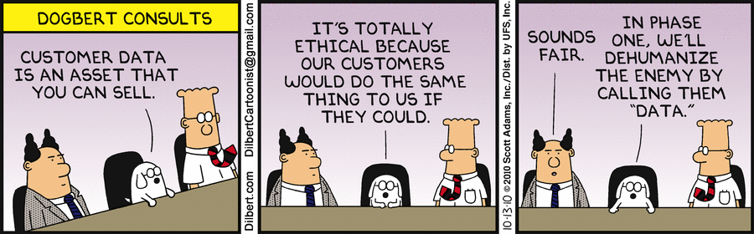

Slide 3
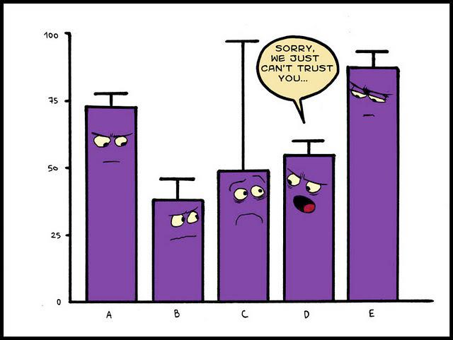
Outline
Normalization/Whitening
Standardization
Normalization
Whitening
Feature Detection
Edge/Corner Detection
Blob Detection
Hough Transform
Feature Detection 2.0

Slide 4
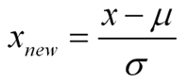
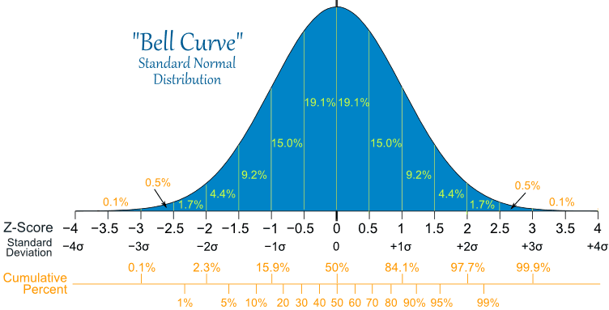
Standardization vs. Normalization
Standardization transforms the data to have zero mean and unit variance.

Slide 5
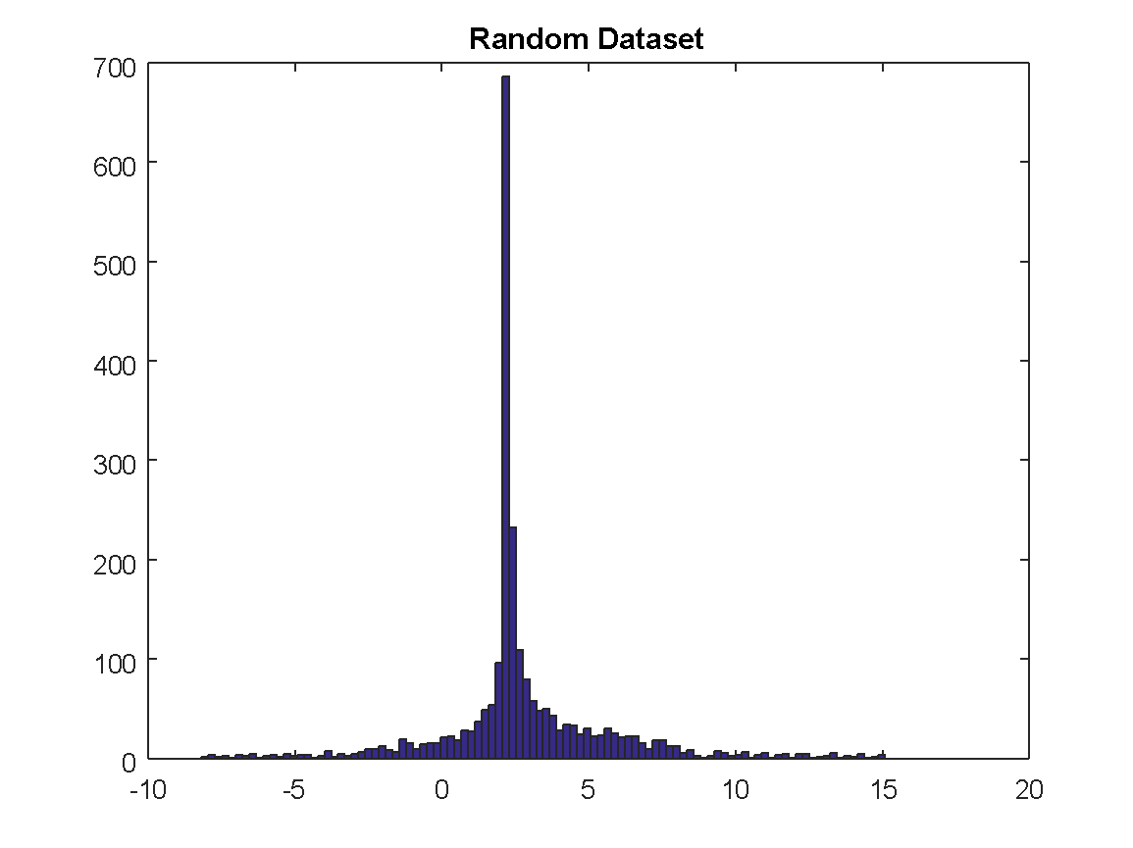
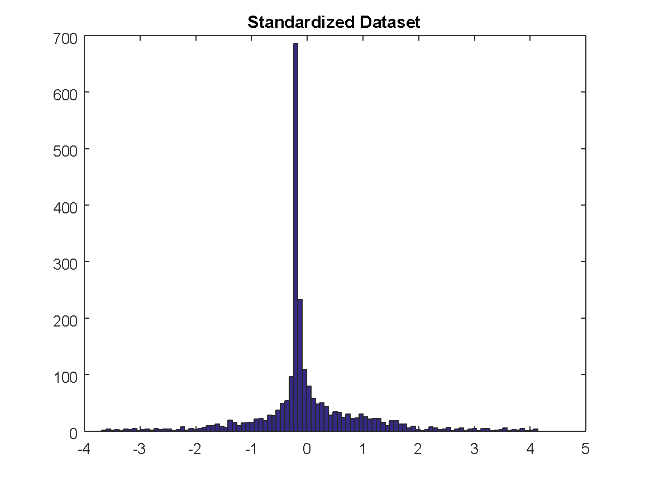
Standardization Example
In Matlab
standard_data = zscore(random_dataset);

Slide 6
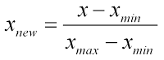
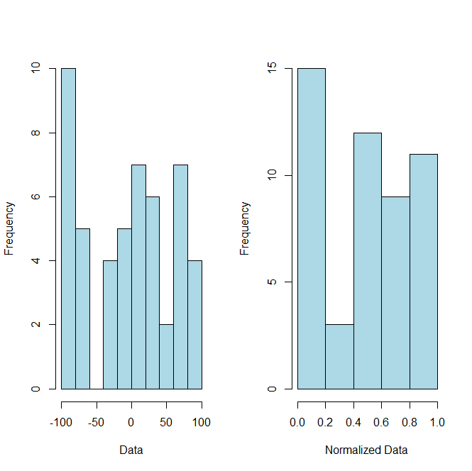
Standardization vs. Normalization
Normalization, scales all numeric variables in the range [0,1].

Slide 7
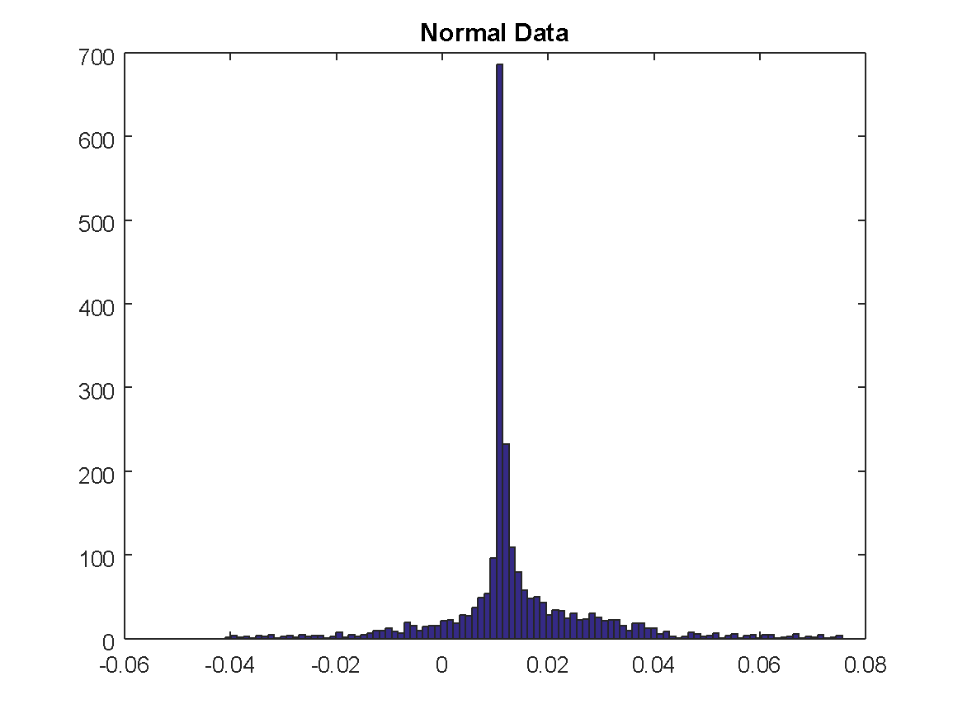
Normalization Example
In Matlab
normal_data = random_dataset/norm(random_dataset);

Slide 8
Normalization Jupyter Example

Slide 9
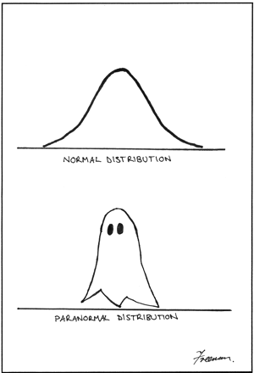
Standardization vs. Normalization
Strengths:
Logarithms of input data. Need to exercise caution when data contains zeros and negative values.
Drawbacks:
If you have outliers in your data set, normalizing your data will certainly scale the “normal” data to a very small interval.
May need to Winsorize (remove extreme values)

Slide 10
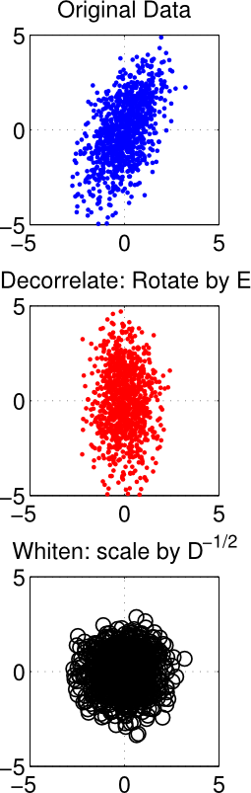
Whitening
Whitening is a linear transformation that transforms a vector of random variables with a known covariance matrix into a set of new variables whose covariance is the identity matrix meaning that they are uncorrelated and all have variance 1.
Original
The second operation, can be thought of as squeezing the data–if the variance along a dimension is larger than one–or stretching the data–if the variance along a dimension is less than one.
The stretching and squeezing forms the data into a sphere about the origin (which is why whitening is also referred to as “sphering”). This scaling operation is depicted in the bottom row in the plot above.
Decorrelation/
PCA
Whitened Data

Slide 11

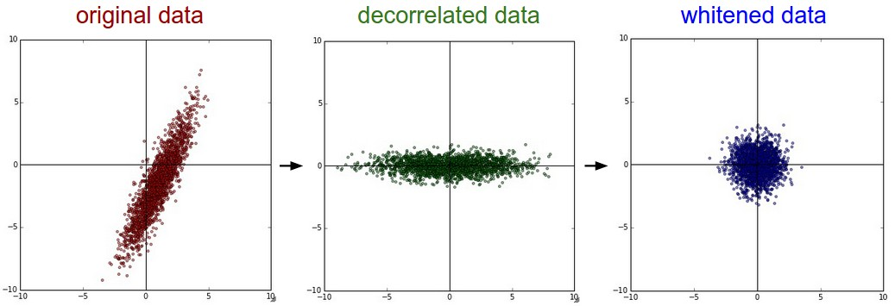
Whitening Example
The goal of whitening is to make the input less redundant; where
(i) the features are less correlated with each other, and
(ii) the features all have the same variance.

Slide 12
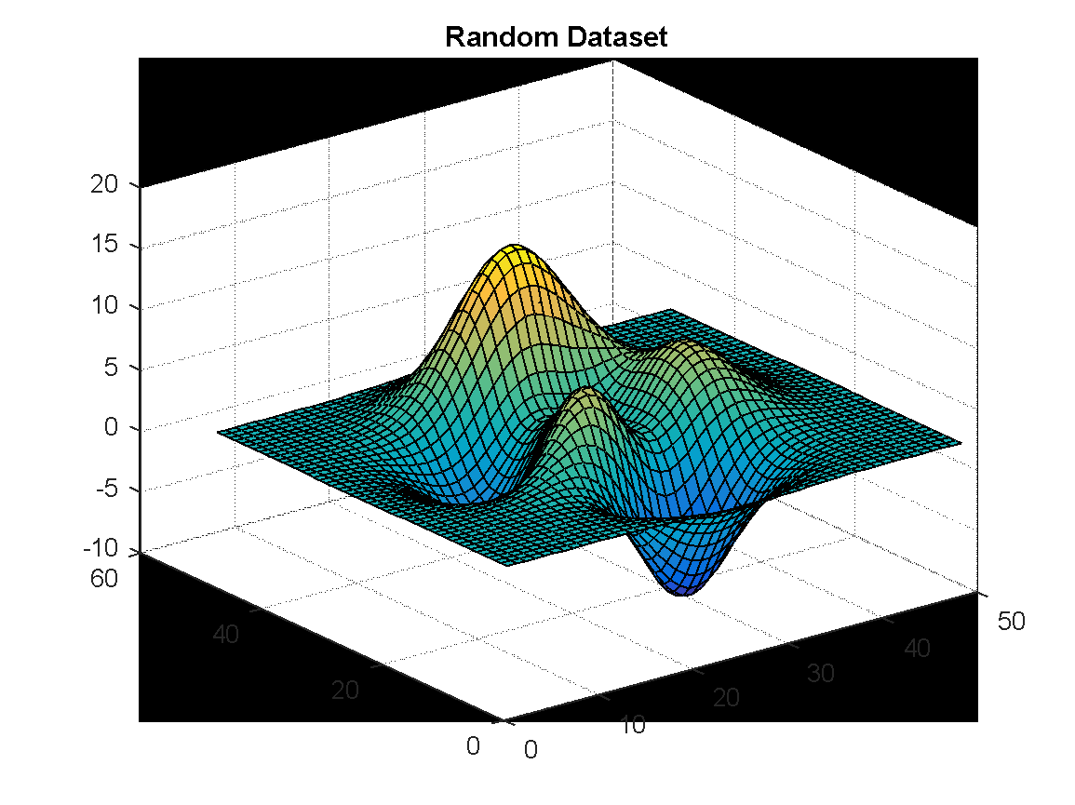
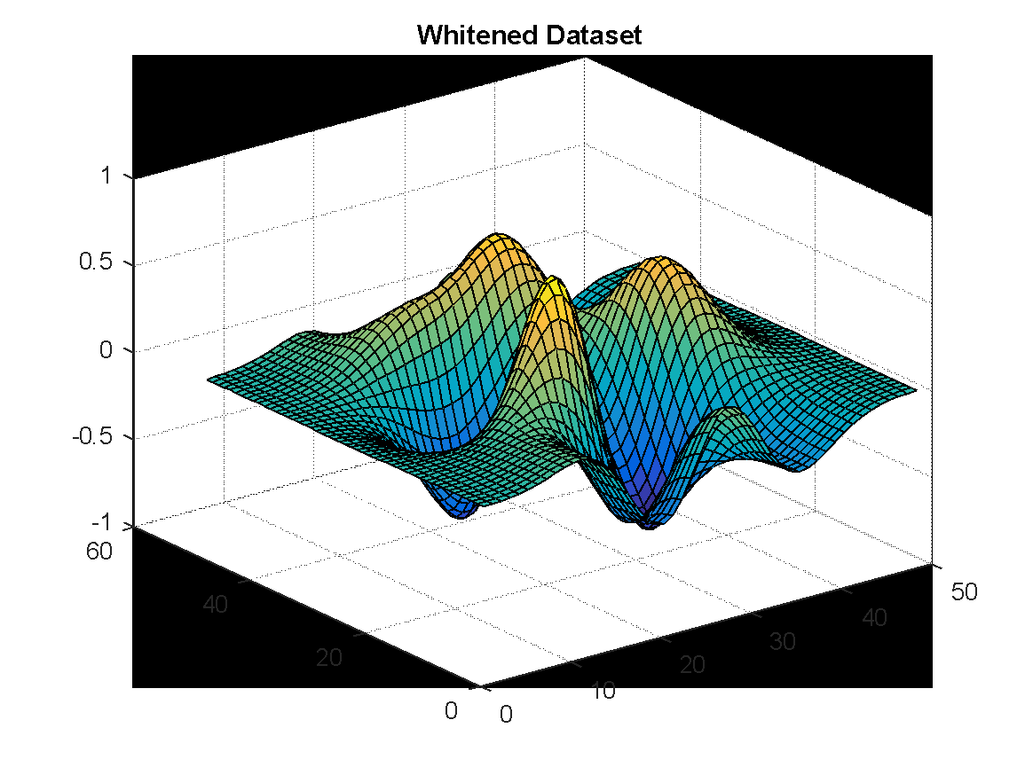
Whitening Example
The goal of whitening is to make the input less redundant; where
(i) the features are less correlated with each other, and
(ii) the features all have the same variance.

Slide 13
Whitening Jupyter Example

Slide 14
Feature Detection and Extraction
Feature extraction involves reducing the amount of resources required to describe a large set of data.
Feature extraction is a general term for methods of constructing combinations of variables to get around problems in memory and computing power (for large datasets) while still describing the data with sufficient accuracy.
Independent component analysis
Kernel PCA
Latent semantic analysis
Partial least squares
Principal component analysis
Multifactor dimensionality reduction
Nonlinear dimensionality reduction
Multilinear subspace learning
Applicable to any data

Slide 15
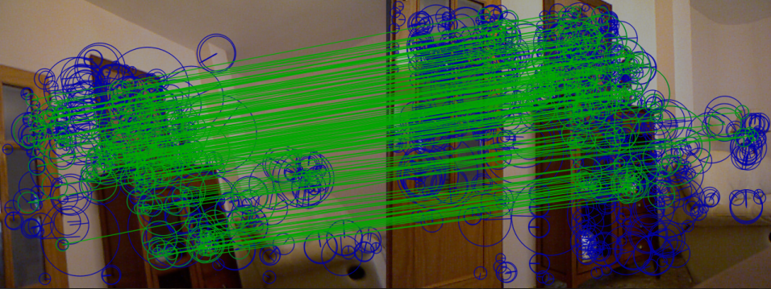
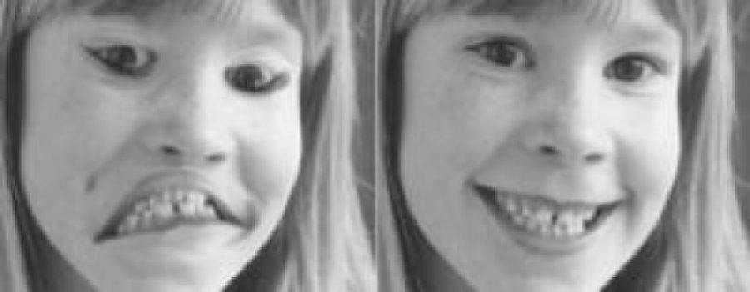
Feature Detection and Extraction in Images
Some image specific processing avenues include:
Edge detection
Corner detection
Blob detection
Shape identification
Motion detection
Thresholding
Hough Transform

Slide 16
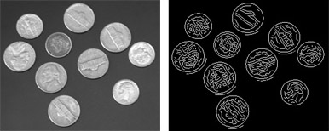
Edge Detection
Edge detection aims at identifying points in a digital image where brightness changes sharply or, more formally, has discontinuities.
Why and how Edge Detection can be challenging
?

Slide 17
Edge Detection
Most methods can be grouped into two categories, search-based and zero-crossing based.
Search-based
Detects edges by first computing a measure of edge strength, through a first-order derivative expression, and then searching for local directional maxima of the gradient magnitude.
Zero-crossing based
Searches for zero crossings in a second-order derivative expression computed from the image in order to find edges, usually the zero-crossings of the Laplacian or the zero-crossings of a non-linear differential expression.
The edge detection methods mainly differ in the types of smoothing filters that are applied and the way the measures of edge strength are computed.
As many edge detection methods rely on the computation of image gradients, they also differ in the types of filters used for computing gradient estimates in the x- and y-directions.

Slide 18
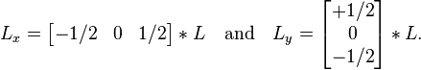
Edge Detection
The simplest approach is to use central differences:
Corresponding to the application of the following filter masks to the image data:
Given such estimates of first-order image derivatives, the gradient magnitude is then computed as:
While the gradient orientation can be estimated as
Once we have computed a measure of edge strength, the next stage is to apply a threshold, to decide whether edges are present or not at an image point. The lower the threshold, the more edges will be detected, and the result will be increasingly susceptible to noise and detecting edges of irrelevant features in the image. Conversely a high threshold may miss subtle edges, or result in fragmented edges.

Slide 19
Edge Detection Jupyter Example

Slide 20
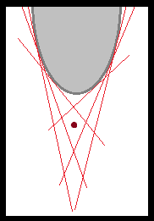
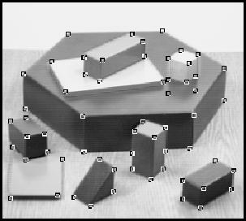
Corner Detection
A corner can be defined as the intersection of two edges. A corner can also be defined as a point for which there are two dominant and different edge directions in a local neighbourhood of the point.
Corner detectors are not usually very robust and often require large redundancies introduced to prevent the effect of individual errors from dominating the recognition task.
One determination of the quality of a corner detector is its ability to detect the same corner in multiple similar images, under conditions of different lighting, translation, rotation and other transforms.
A simple approach to corner detection in images is using correlation, but this gets very computationally expensive and suboptimal.
The Förstner corner detector

Slide 21
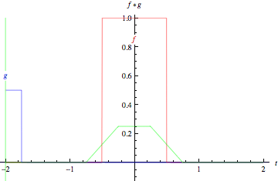
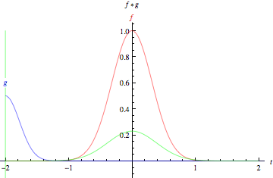
Convolution
Convolution is an integral that expresses the amount of overlap of one function g as it is shifted over another function f.
The animations graphically illustrate the convolution of two boxcar functions (top) and two Gaussians (bottom).
In the plots, the green curve shows the convolution of the blue and red curves as a function of t, the position indicated by the vertical green line.
The gray region indicates the product g(τ)f(t- τ) as a function of t, so its area as a function of t is precisely the convolution.

Slide 22
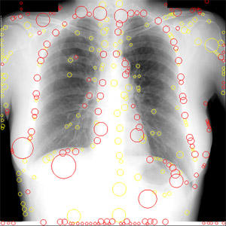
Blob Detection
Blob detection is aimed at detecting regions in a digital image that differ in properties, such as brightness or color, compared to surrounding regions.
A blob is a region of an image in which some properties are constant or approximately constant; all the points in a blob can be considered in some sense to be similar to each other.
Laplacian of the Gaussian (LoG)
A given image is convolved with a Gauss kernel at a given scale t
The result of Laplacian operator is then
which usually results in strong positive responses for dark blobs of radius
and strong negative responses for bright blobs of similar size.

Slide 23
Feature Detection Jupyter Example

Slide 24
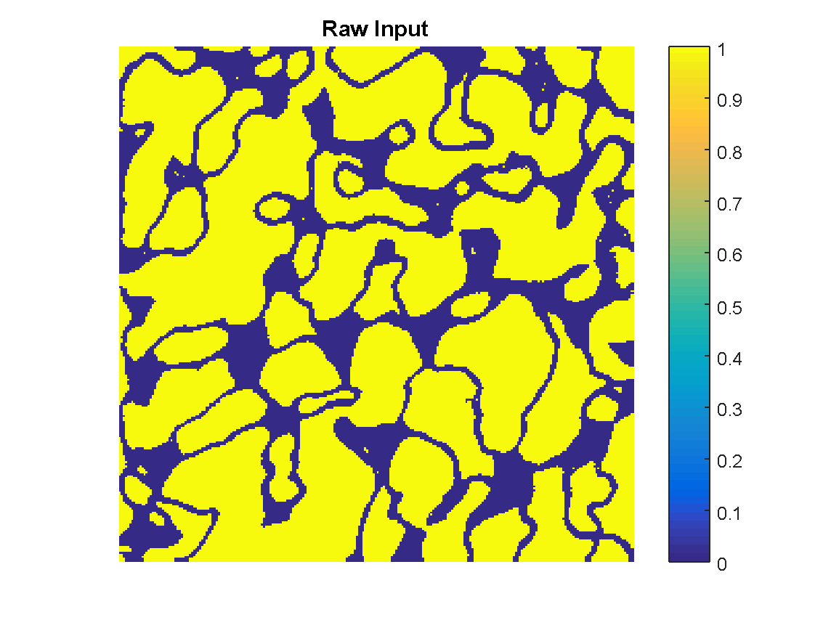
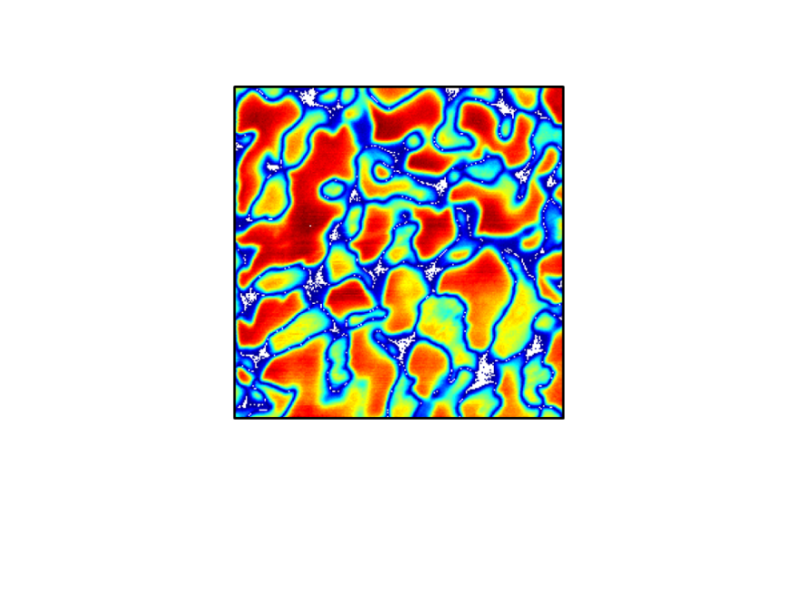
Blob Detection Example, Putting it together
A main problem when applying this operator is that the operator response is strongly dependent on the relationship between the size of the blob structures and the size of the Gaussian kernel used for pre-smoothing.
In order to automatically capture blobs of different (unknown) size in the image domain, a multi-scale approach is therefore necessary.

Slide 25
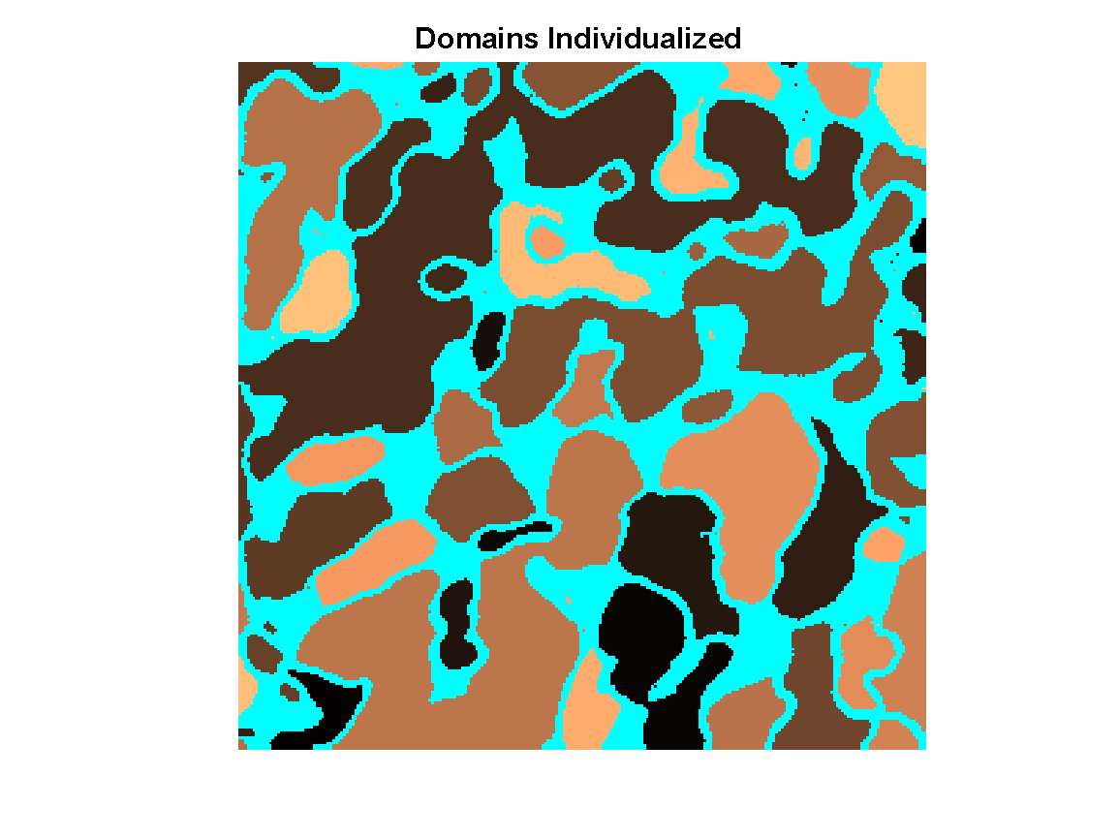
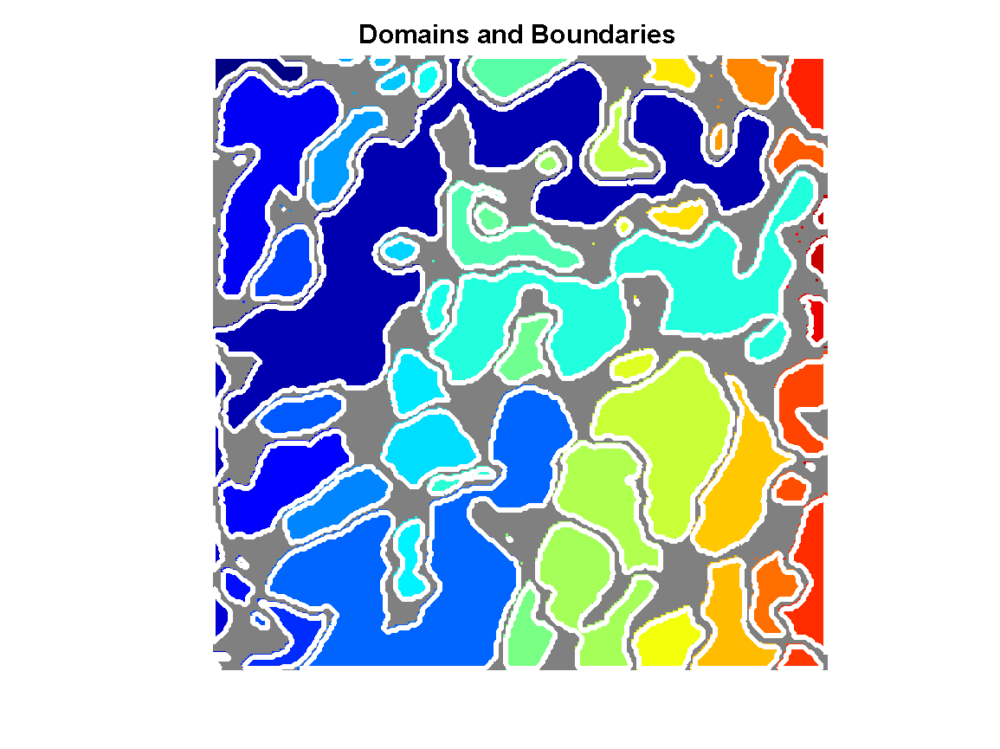
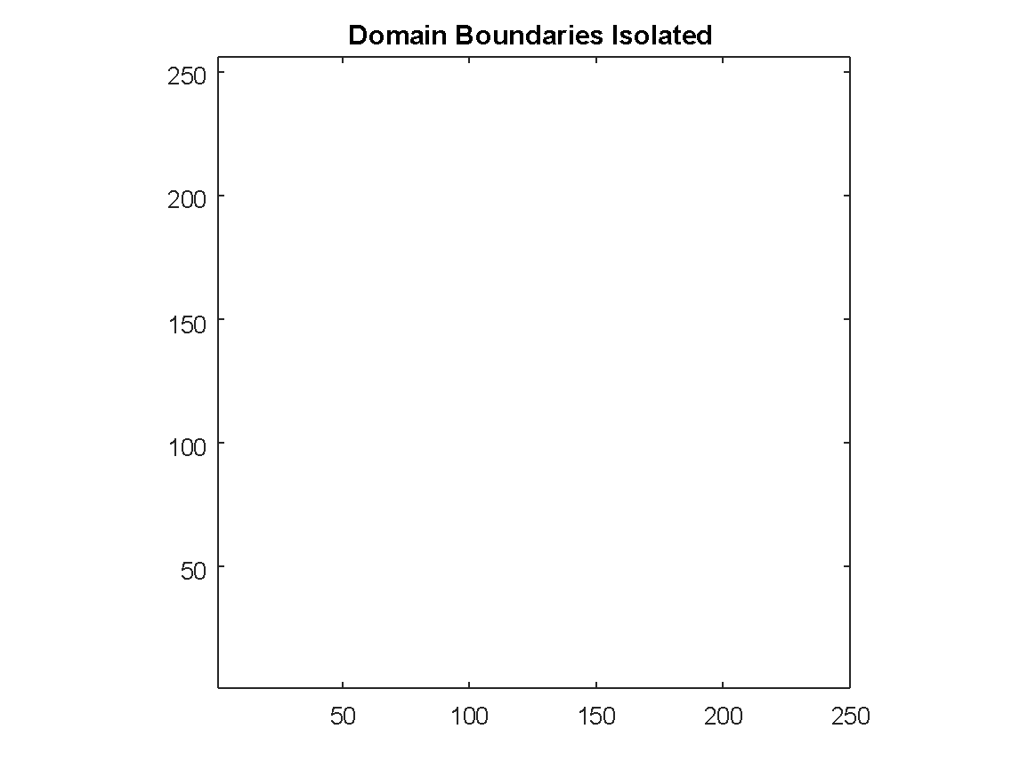
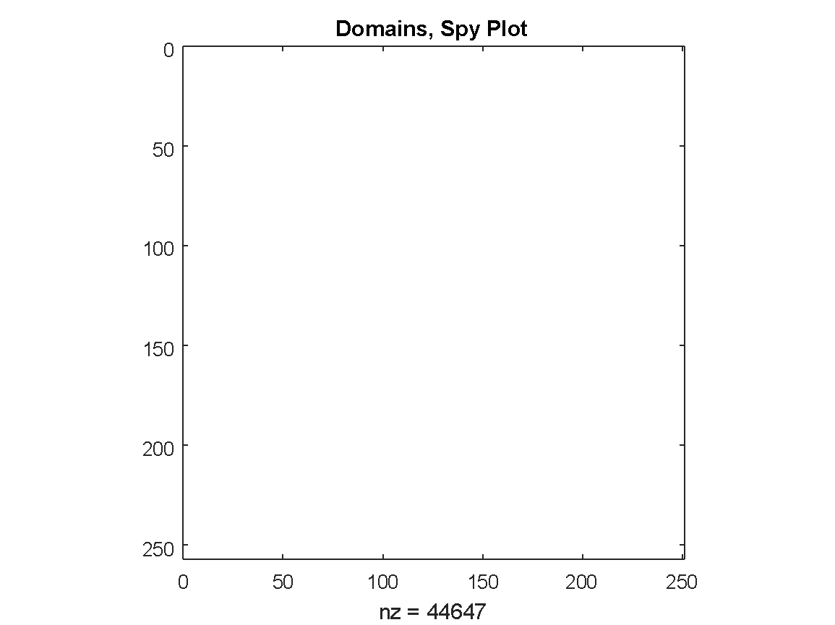

Blob Detection Example, Putting it together

Slide 26
Hough Transform
The purpose of the technique is to find imperfect instances of objects within a certain class of shapes by a voting procedure.
The simplest case of Hough transform is detecting straight lines.
The linear Hough transform algorithm uses a two-dimensional array, called an accumulator, to detect the existence of a line described by:
The final result of the linear Hough transform is a two-dimensional array. One dimension of this matrix is the quantized angle θ and the other dimension is the quantized distance r.
Each element of the matrix has a value equal to the sum of the points or pixels that are positioned on the line represented by quantized parameters (r, θ).
So the element with the highest value indicates the straight line that is most represented in the input image.

Slide 27
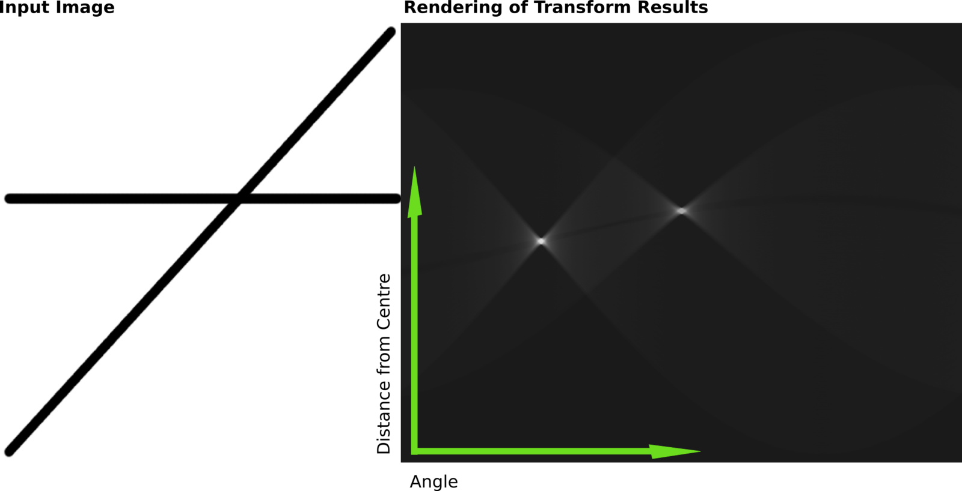
Hough Transform
The results of this transform were stored in a matrix. Cell value represents the number of curves through any point. Higher cell values are rendered brighter. The two distinctly bright spots are the Hough parameters of the two lines. From these spots' positions, angle and distance from image center of the two lines in the input image can be determined

Slide 28
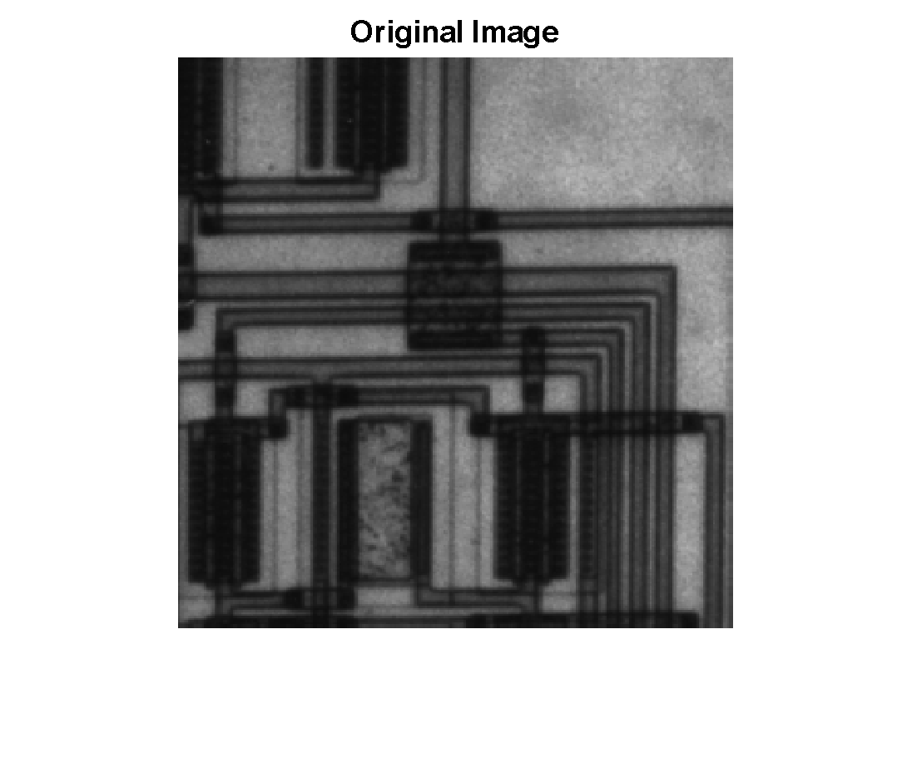
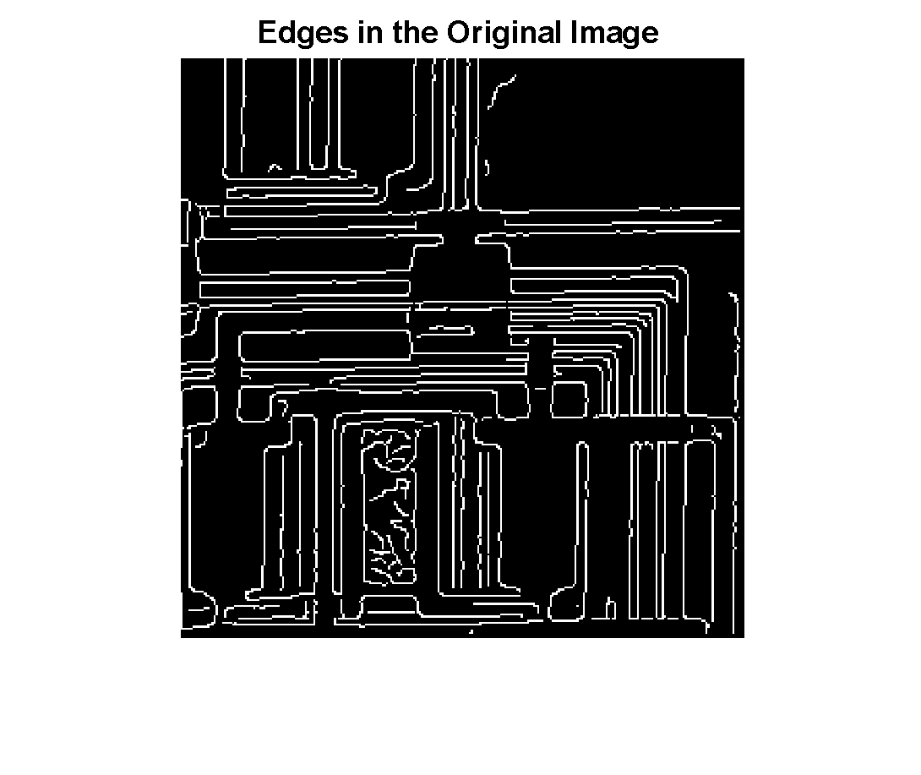
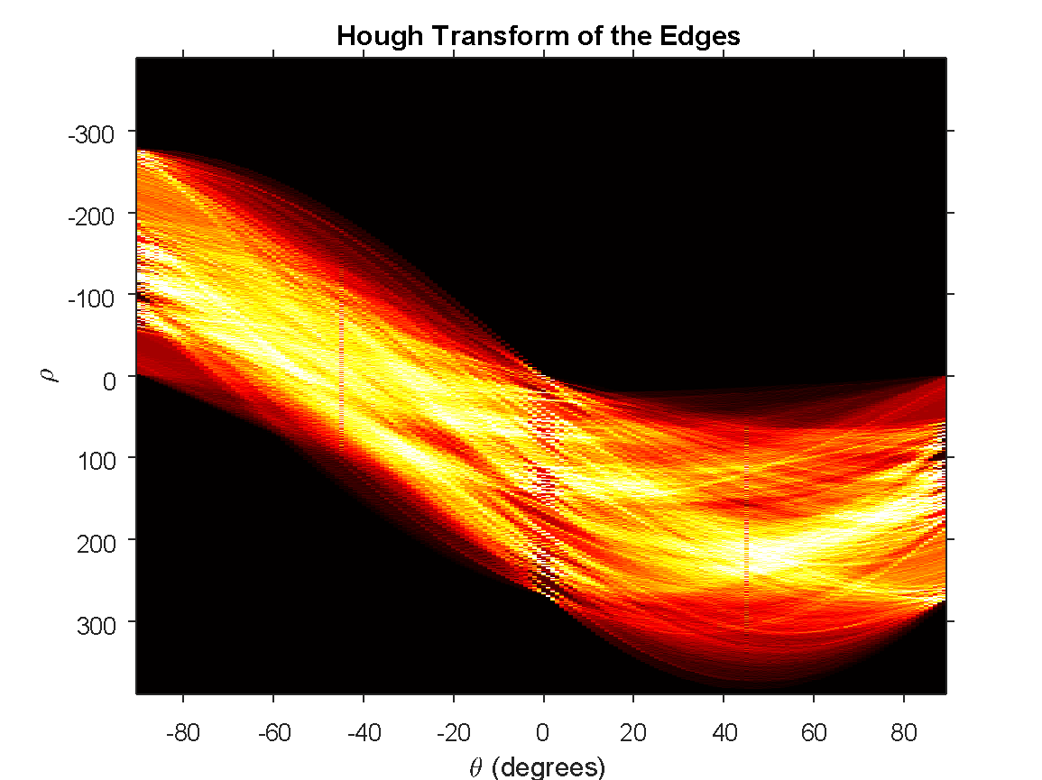
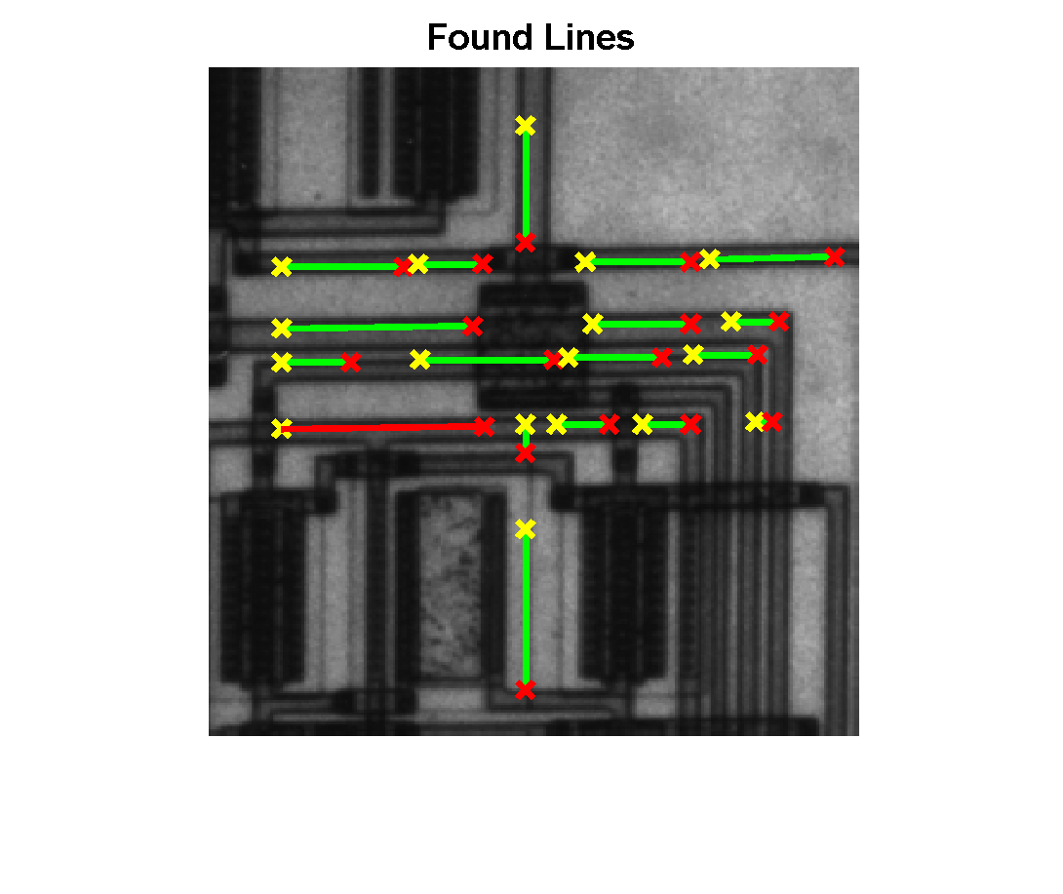
Hough Transform Examples

Slide 29
Hough Transform Jupyter Example

Slide 30
Feature Detection 2.0
Everyone’s data is special, and sometimes a cookie cutter example doesn’t work
Q: What to do when you want to compare features within the data?
A: Make patches, and compare those!
Breaking the data into regions allows more flexibility in:
Object Tracking
Compute Distribution
Challenging Data
Creates a modular testing environment

Slide 31
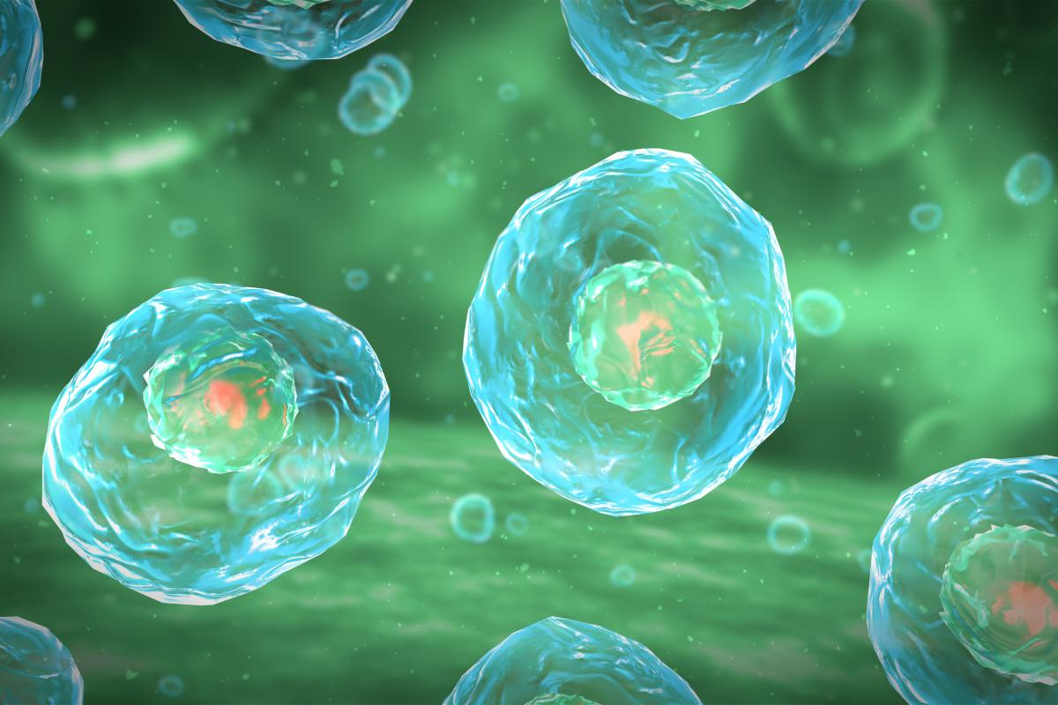


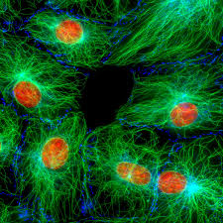
Feature Detection 2.0

Slide 32
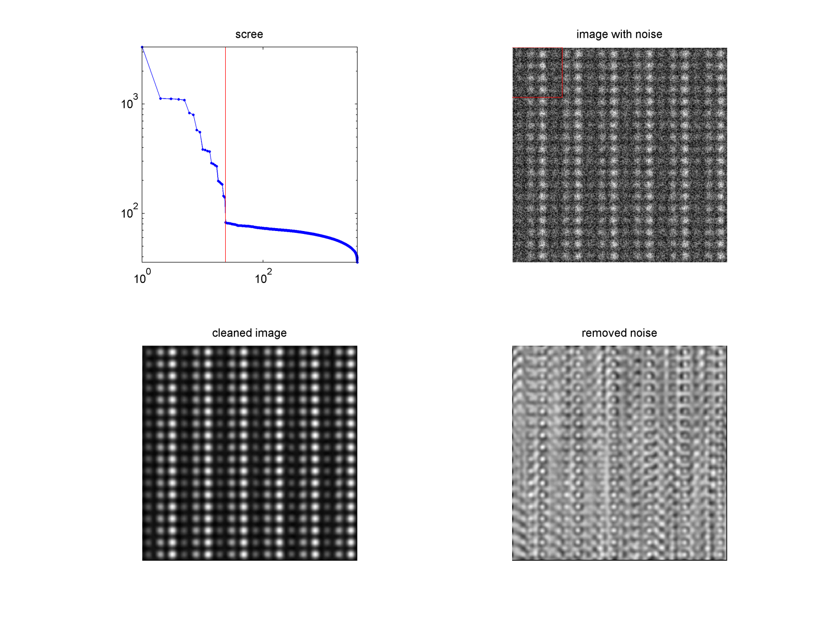
Feature Detection 2.0
Modelled Image: 256X256 pixels
window size
PCA cutoff

Slide 33
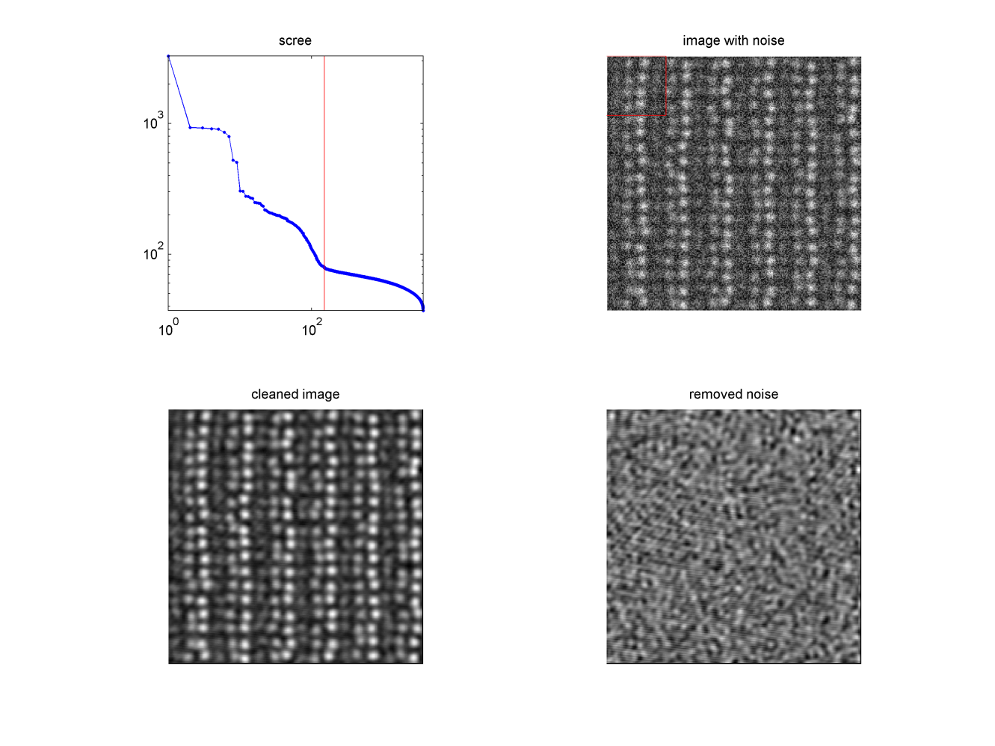
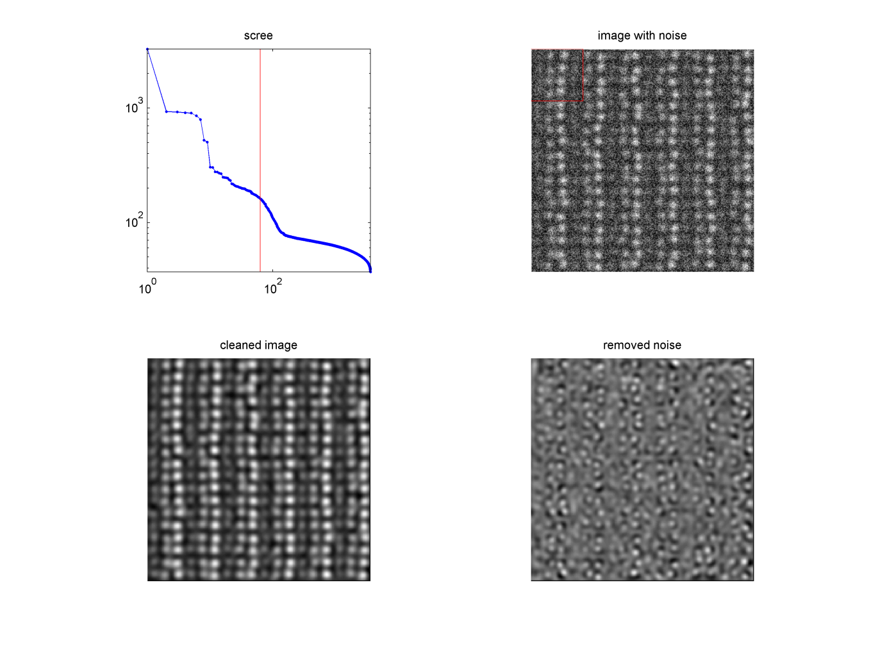
Feature Detection 2.0
In this case, repeatability of the structure was diminished by randomizing the locations slightly. As expected this resulted in an increase in the number of PC’s that are needed to reconstruct the image. Below are two examples of denoising on the same data set but with different levels of denoising.

Slide 34
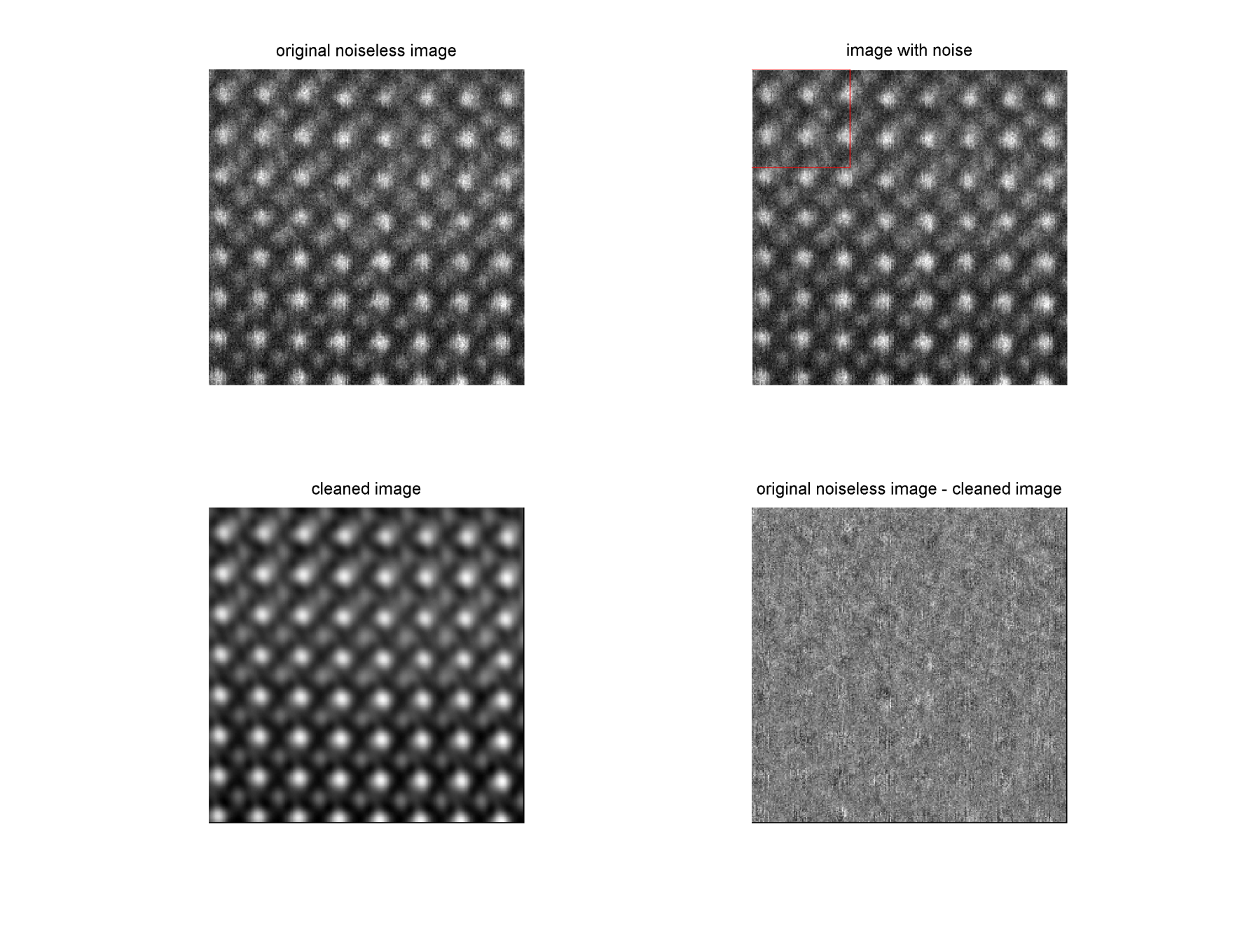
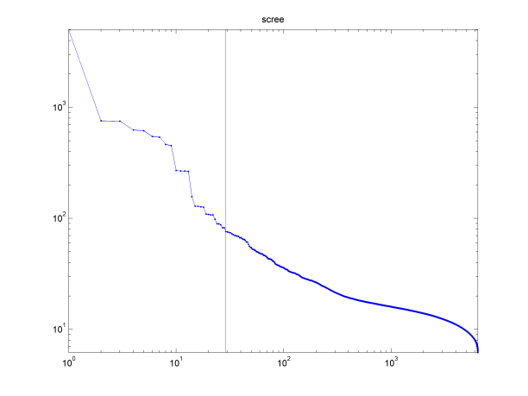
Feature Detection 2.0
Actual Experimental Image: 256X256
Original image
Remaining Noise

Slide 35
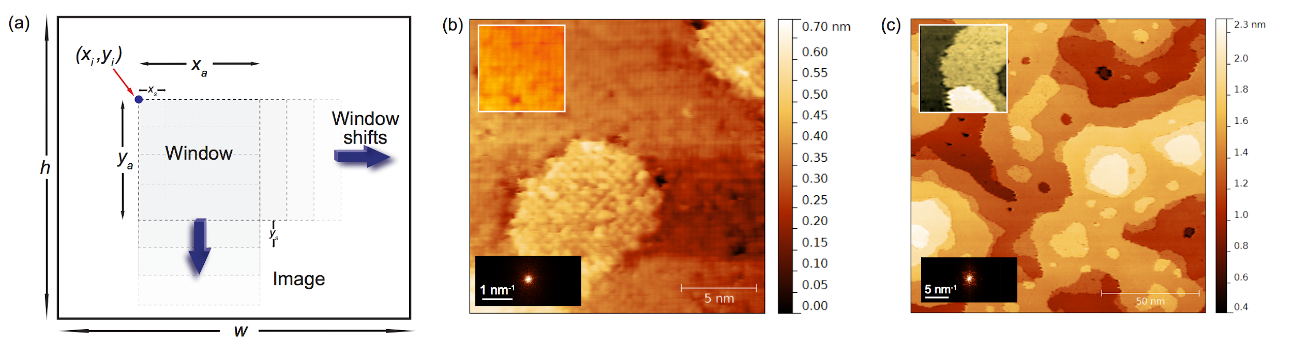
Feature Detection 2.0
Actual Scientific experiments (harder to process images) where the question is whethed the different regions captured by STM have the same or different surface reconstruction.
Analysis was performed on the FFT images of each of the image slices

Slide 36
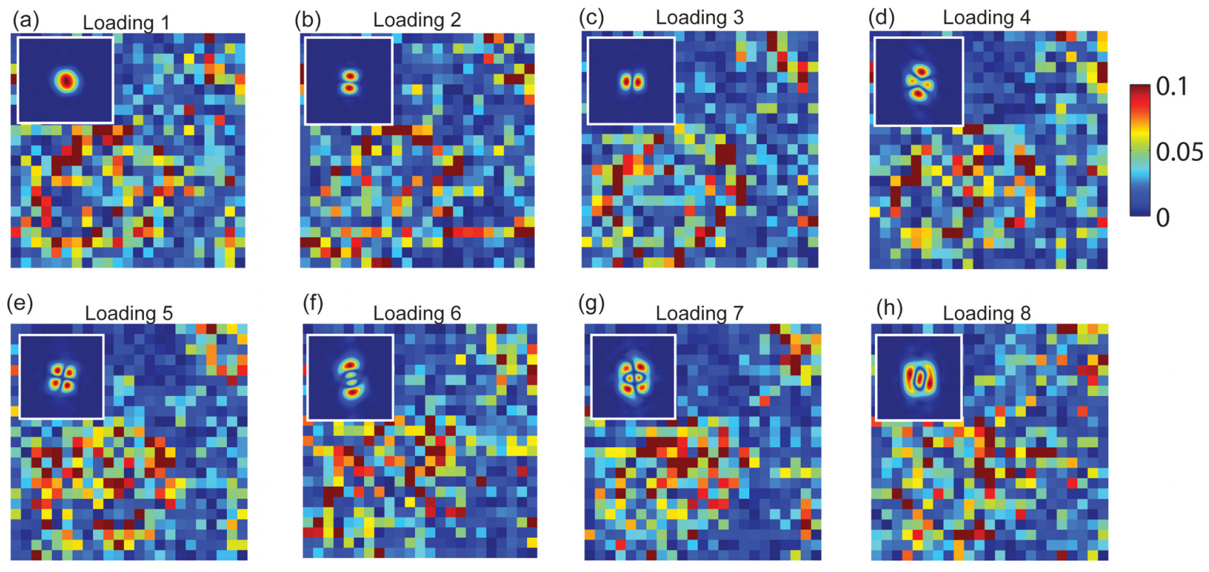
Feature Detection 2.0
The analysis (PCA) shows the dissimilarity in the FFT (inset) and how it maps on the real-space structure.

Slide 37
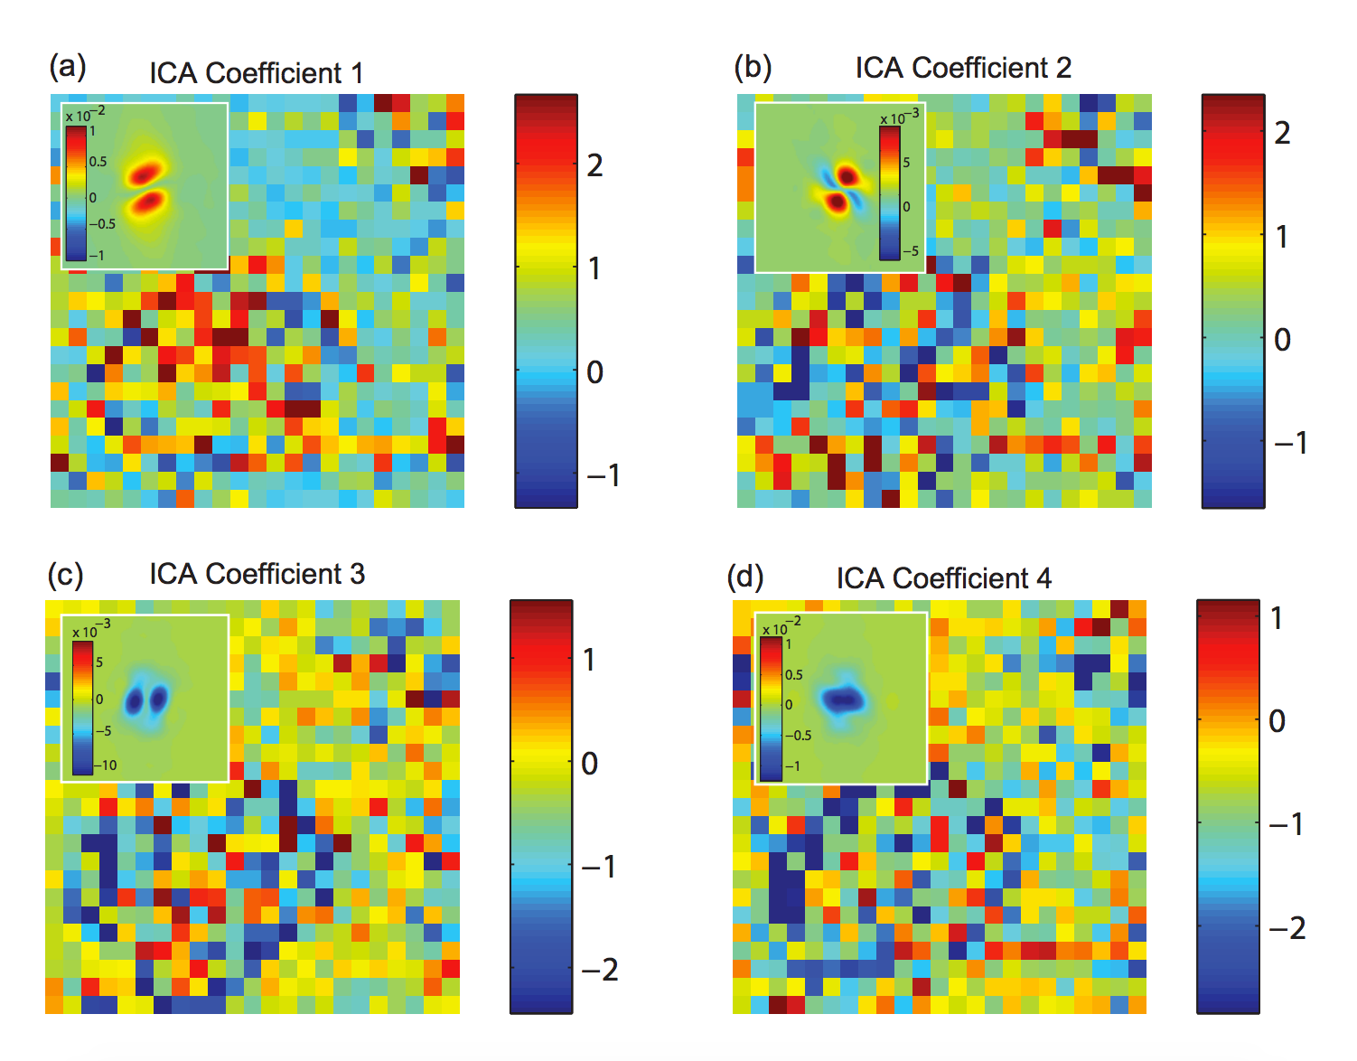
Feature Detection 2.0
This analysis (ICA) shows the dissimilarity in the FFT (inset) as if the sources of the signal were fully independent (a valid assumption here) and how it maps on the real-space structure.

Slide 38
Feature Detection 2.0 Jupyter Example

Slide 39
Conclusions
Normalization/Whitening
Know how and why to alter your data to maximize the impact of downstream methods. Properly pre-processed data will accentuate the features you’re interested in. Poorly processed data will obfuscate them.
Feature Detection
Systematic feature exploration may reduce your data and highlight the interrelationships captured within. Forces eloquent description of the data. Naturally transitions to parametric fitting.
Feature Detection 2.0
“There’s plenty of fish in the sea.” It is possible to be very creative with processing methods. Figure out what it is you’d like to track/extract/learn and see if others had solved this general problem.

Slide 40
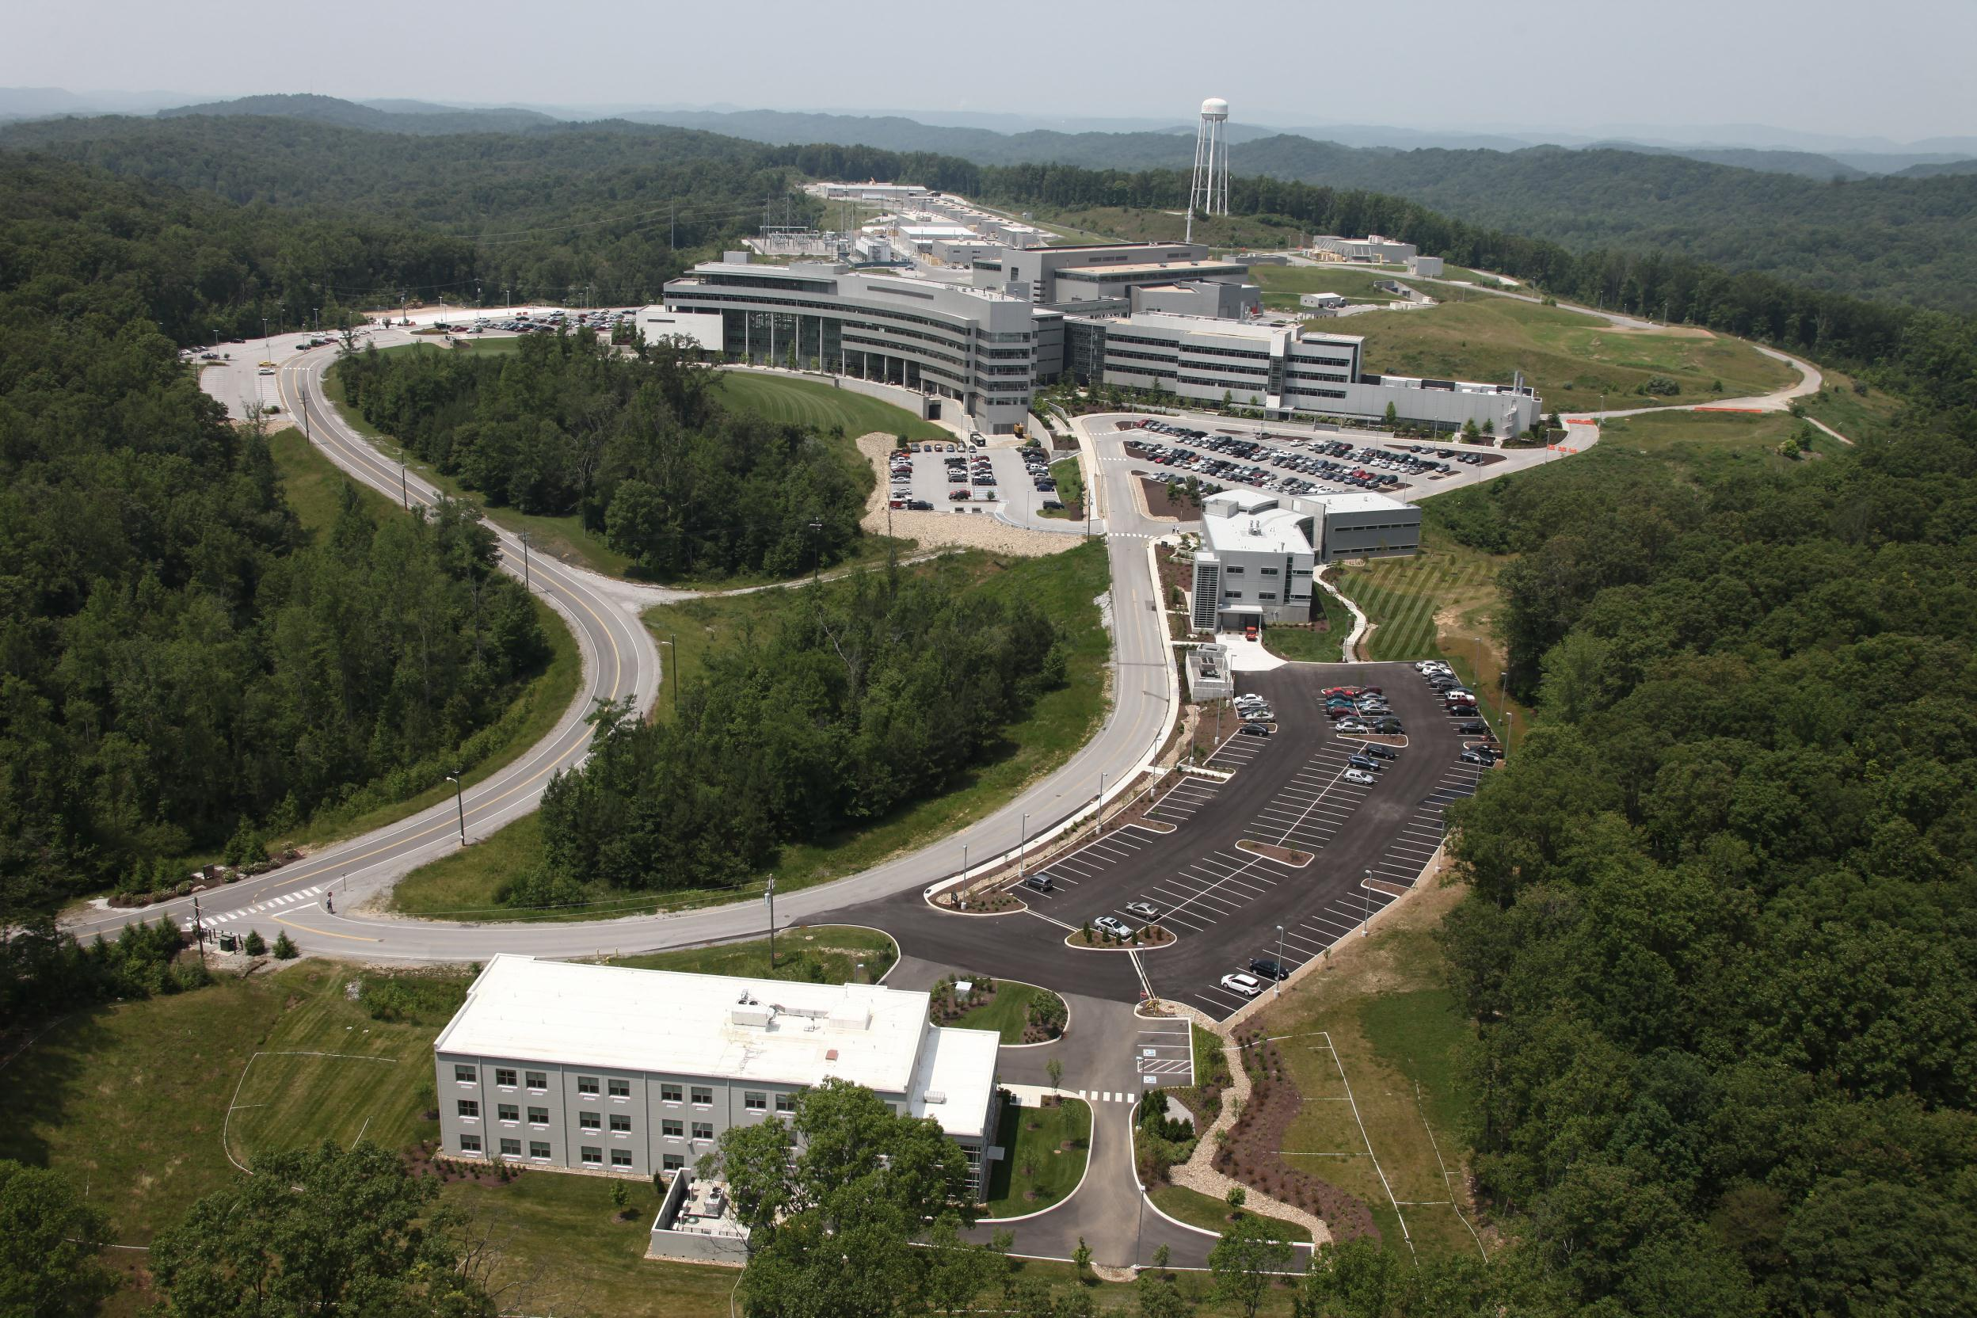
Thank you!
Rapid Access User Proposal
Submission open!
belianinova@ornl.gov

